Slide 1
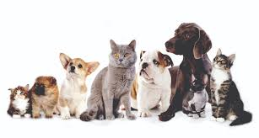
Analysis of Pet Adoptions in Malaysia to determine ideal adoption locations based on physical criteria.
Team BAM!
Lillian Bolfer, Mike Machata, and Rob Phillips

Slide 2
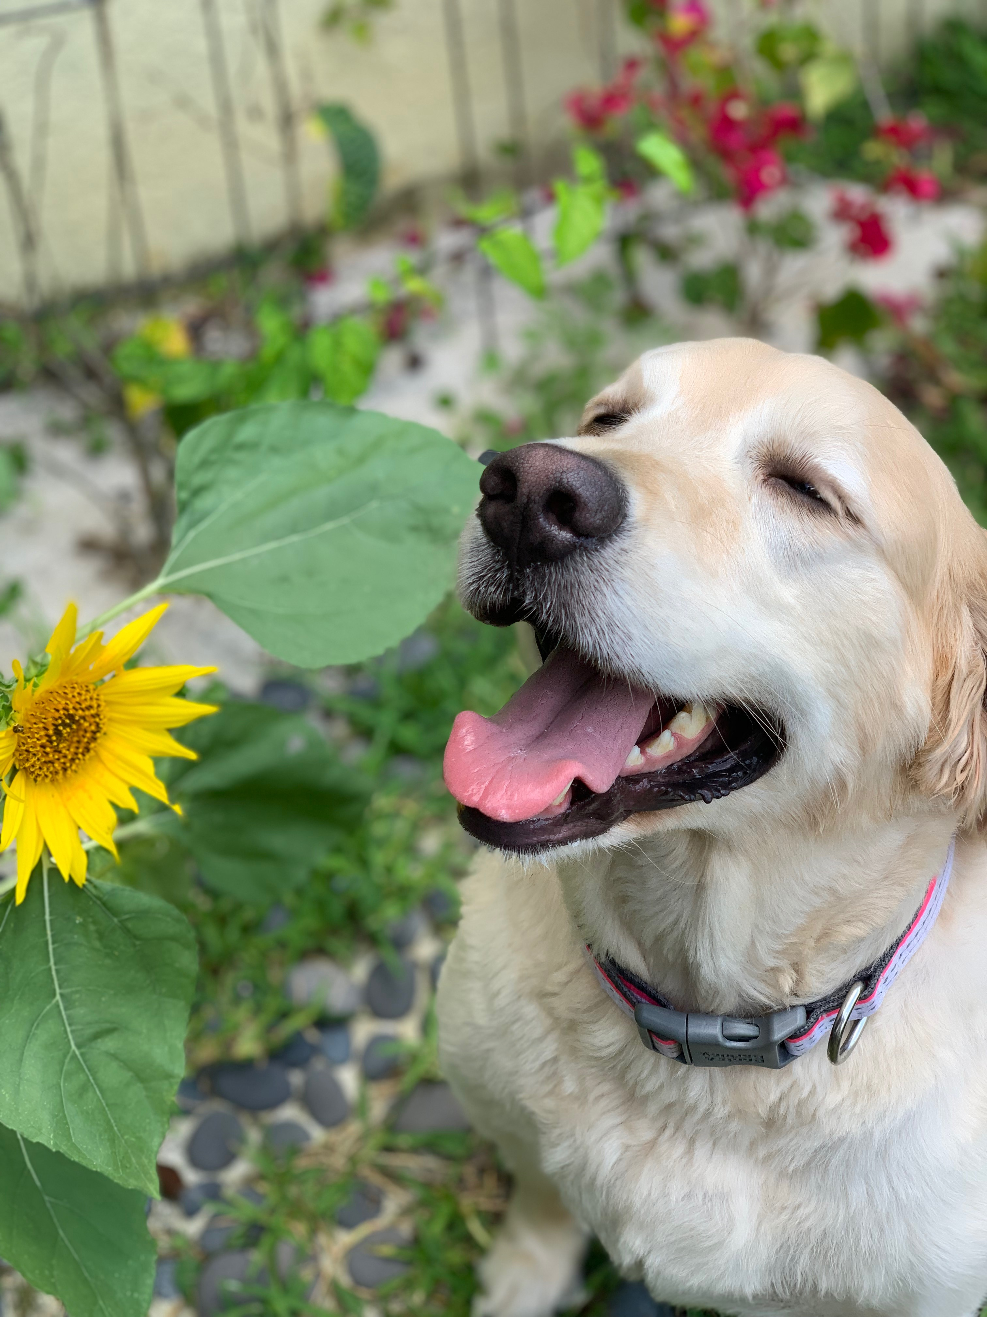
Story:
Animal adoption rates are strongly correlated to the metadata associated with their online profiles, such as descriptive text and photo characteristics.
Our goal as an animal fostering agency in Malaysia is to use adoption data from PetFinder.my to identify the ideal locations for our adoption events and which types of animals are most likely to get adopted (based on breed and color) in these areas so we can optimize our events and get more furry friends adopted!
Our company wanted a dynamic webpage to find this information so they ran a competition on Kaggle.com, and this research is available on our webpage.

Slide 3
Objectives:
From our perspective, our company wants to know the best locations to open a dog shelter, have an adoption event, or foster out specific breeds and colors by postcode in order that they are adopted quickly.
None of the Kaggle adoption data and analysis is readily available to industry and adopters. So our challenge was to host the data sets and queries as an API and provide some basic interactive charts to summarize adoption trends by postcode (color, breed, adoption rate).
Through use of the charts and API, our new web site will now service a variety of industries looking at integrating into a booming segment.

Slide 4
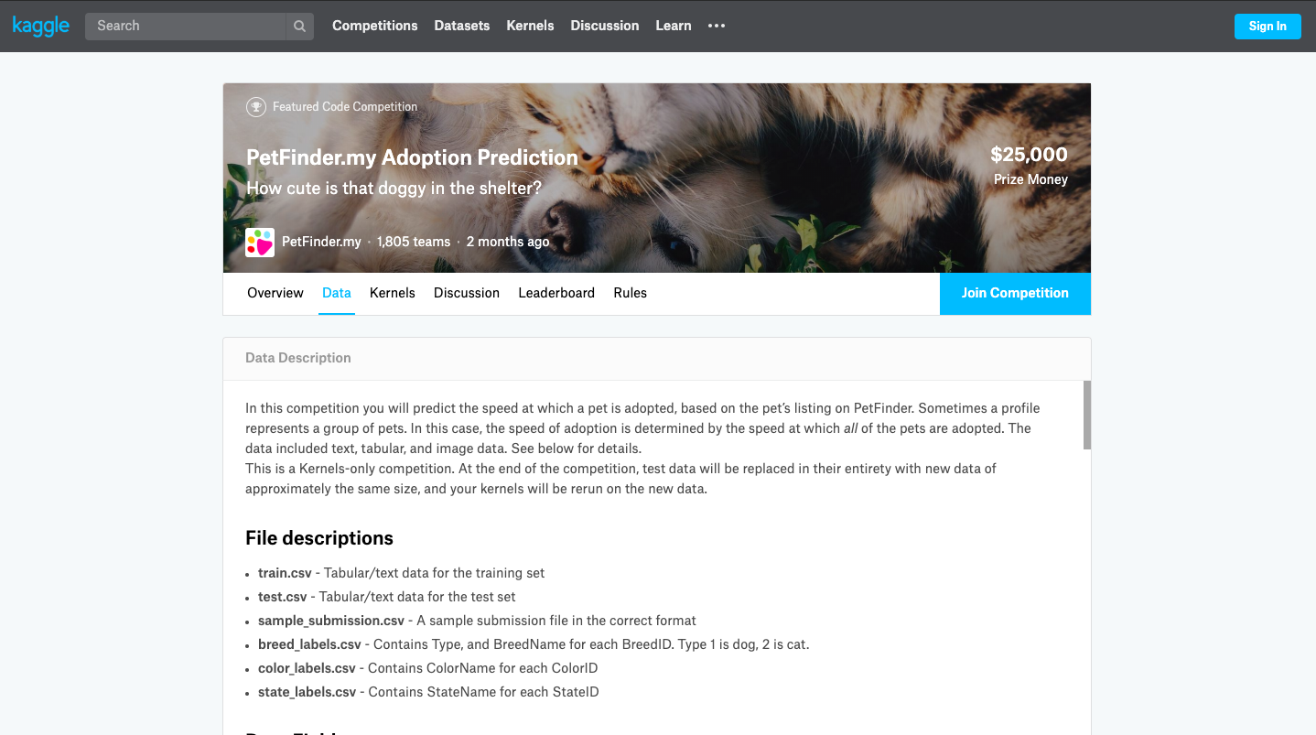
Dataset:
Our project utilized and built upon an existing pet adoption project on Kaggle.com
https://www.kaggle.com/c/petfinder-adoption-prediction/data
The dataset was comprised of 15,000 historical adoptions, and we extracted the color of the pet based on 7 different color categories (Black, Brown, Golden, Yellow, Cream, Gray, and White), the breed of the pet (317 breeds), the zip code they were adopted from, and the adoption speed (scaled 0-4).

Slide 5
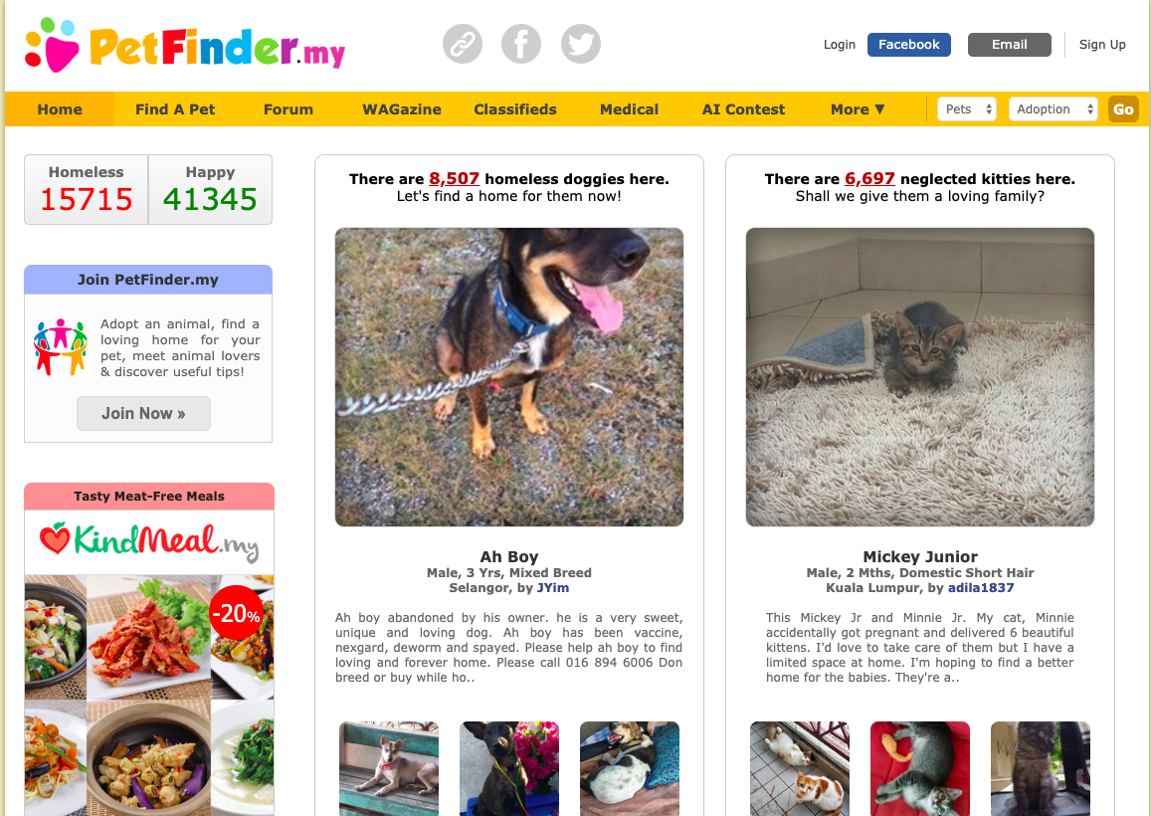
PetFinder.my is the website the data is pulled from. It has been Malaysia’s leading animal welfare platform since 2008, with a database of more than 150,000 animals. PetFinder collaborates closely with animal lovers, media, corporations, and global organizations to improve animal welfare.

Slide 6
Methods:
Pull the data tables from Kaggle and import into an SQLite DB
Extract coordinates of the post codes via Geocode API
Plot the coordinates on a mapbox using Leaflet.js
Create Javascript drop down graphs using Canvas.js that query the SQLite file and dynamically change the webpage
Launch API and server via Heroku
Be awesome

Slide 7
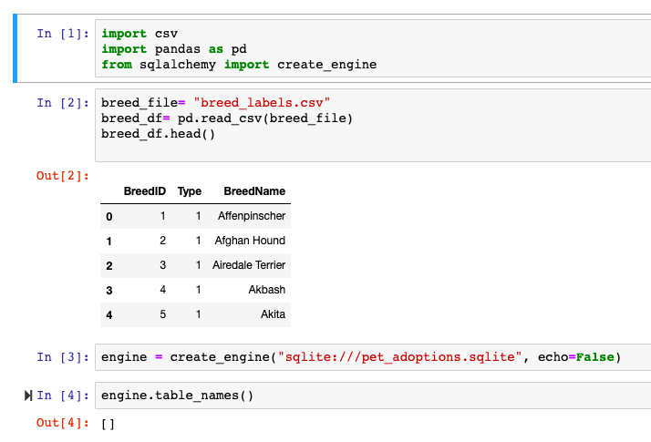
Step 1: Create our SQLite DB, we did this through Jupyter Notebook

Slide 8
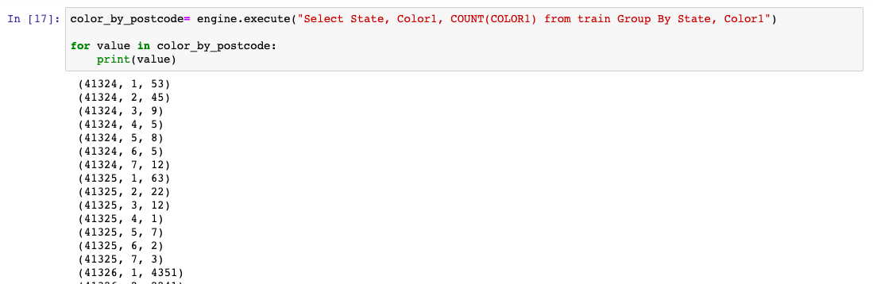
Example SQL query used to determine number of adoptions in the post codes broken down by color code (1-7)

Slide 9
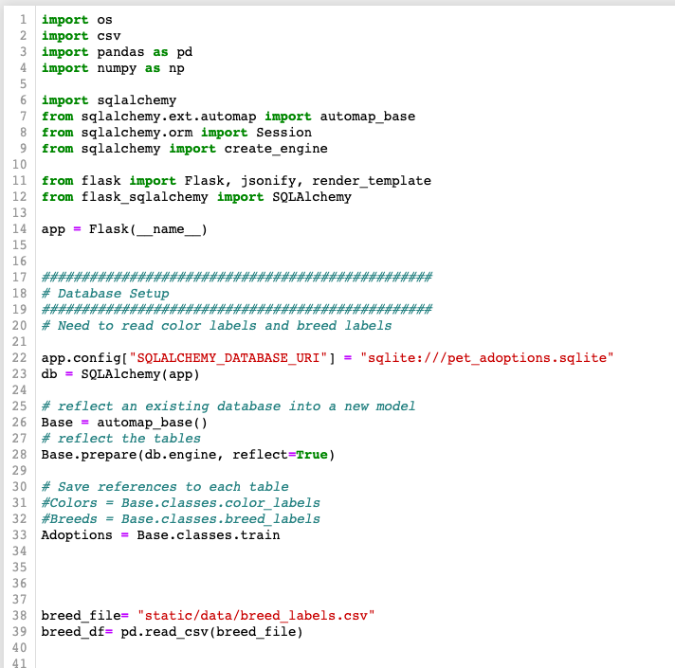
App.py code shows how we reflected the SQLite DB to populate our API request.

Slide 10
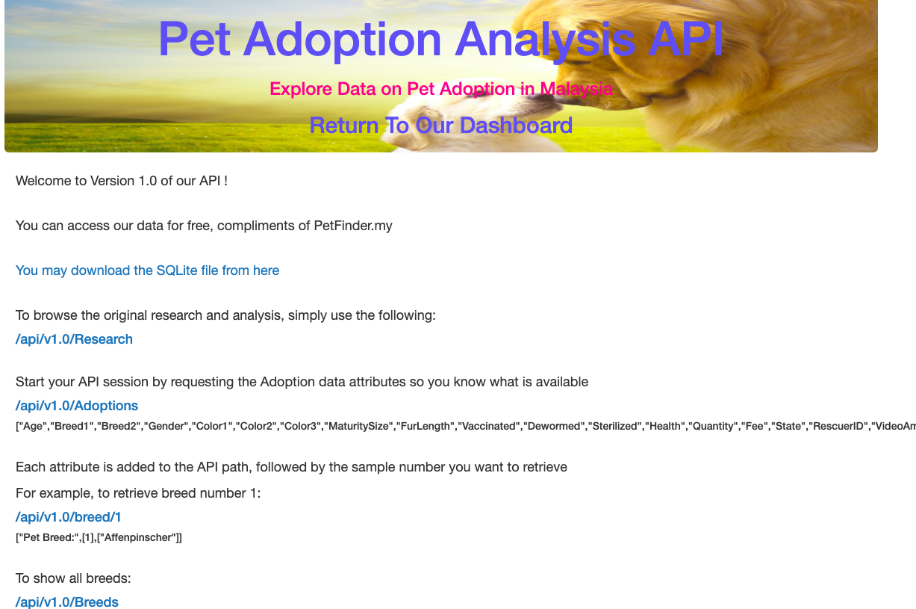
Our API Page . Ta Da!

Slide 11
Map of Post codes in Malaysia,
This helps us determine locations for our events and fostering services.

Slide 12
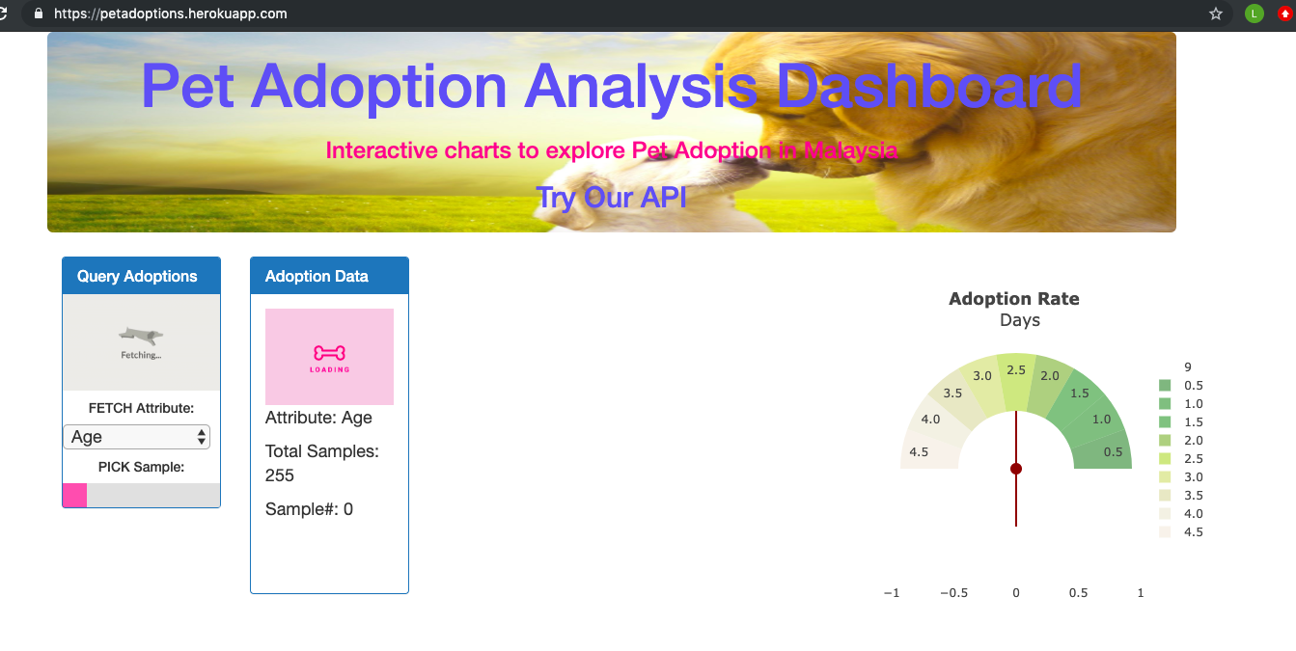
Our webpage! https://petadoptions.herokuapp.com/

Slide 13
We used the Geocode API to find the coordinates for the 15 post codes and create a Mapbox plot. This aspect is still being integrated into our webpage.

Slide 14
Project Challenges
Post codes were too detailed in the original dataset and so the vendor had to obscure peoples personal details and house locations, so the post codes were all made up. We had to go through and global replace all of them, including the 15,000 adoption records to insert the real post codes (just two digit area codes).

